Slide 1
BIG Pharma….the savings you can’t see
NAEN CONFERENCE – March 2017

Slide 2
Definitions
Carve out – employers that have a direct contract with the PBM vs. going through a Health Plan. The plan sponsor must be self-funded.
Carve In – plan sponsors that purchase their prescription coverage using the contract negotiated by their particular Health Plan. Note carve in doesn’t necessarily mean the plan sponsor is fully-insured. Self-funded plan sponsors can also be carved in with the heal Plan.
Formulary – a list of prescription drugs used by PBM’s and Health Plans to identify drugs that offer the greatest overall value to the plan sponsor as well as the patient. Each PBM and Health Plan utilize their own proprietary formulary based on specific criteria which includes drug safety, efficacy and cost among other items. Based on these criteria, PBM’s will identify whether a particular drug is Preferred or Non-Preferred.
MAC Pricing – or Maximum Allowable Cost is applied to a list of drugs that includes the maximum amount that a plan will pay for a particular generic drug. Each PBM uses different MAC lists which are considered proprietary. There is no standardization for MAC lists or the methodology how the maximum price is determined. Often the PBM will generate significant revenue by applying different MAC lists. For example, the PBM may reimburse their network pharmacies using one MAC list and bill the plan sponsor under another, thus generating margin.

Slide 3
Definitions
NDC – National Drug Code and is an 11 digit identifier applied to every drug sold within the United States. The NDC identifies the manufacturer, the drug itself and the package size the drug came in. All claims processed through the PBM require a NDC number which not only helps identify the drug from a price perspective but can identify where the drug cam from in the event of a recall or safety issue.
PMPM – “per member per month” used by the PBM as a measurement for reporting on increases and/or decreases in a plan sponsor’s drug spend.
Rebates - Reimbursements to the PBM from the pharmaceutical manufacturer. Rebates are paid to the PBM in exchange for that particular manufacturer’s drug being included as a Preferred drug on their formulary. Depending on the way the PBM contact is written, the PBM will share a portion of these rebates with plan sponsors. Rebates are also considered “manufacturer copays” by some in the industry.

Slide 4
Understanding the Rules of the Game
The pharmacy and prescription drug industry have been dominated and controlled by a very complex and unregulated business structure, which has allowed pharmaceutical manufactures and Pharmacy Benefit Management Companies (PBM) to reap incredible profits at the expense of public schools.

Slide 5
Another view of the game
Pharmacy industry players
are in a virtual black box with little to no regulatory control
costs
Your
Pharm profits

Slide 6
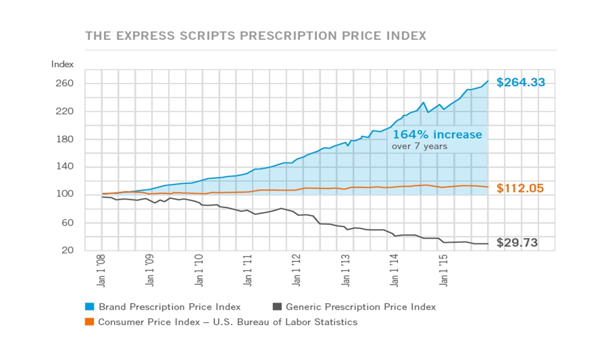

Slide 7
Where are the Savings in Our Pharmacy Benefit Program?

Slide 8
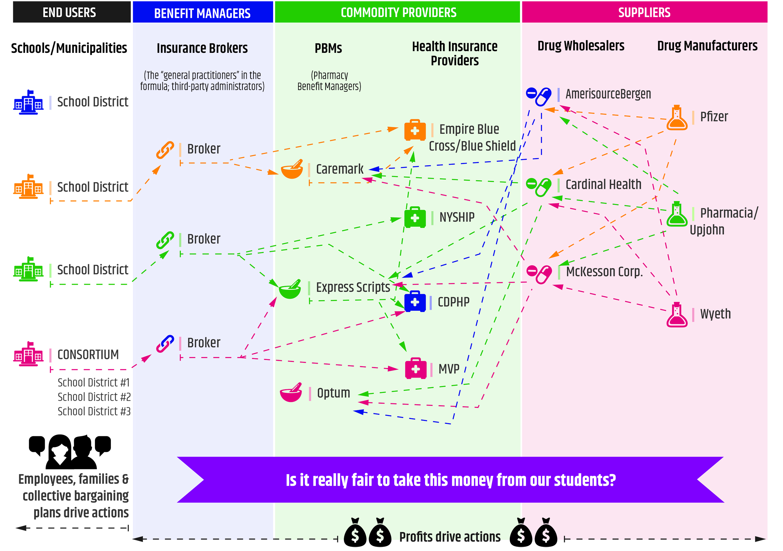
Factor #1- System Complexity
Creates Relationship Confusion

Slide 9
Factor #2 – Role Confusion
Broker – District
Broker – PBM
Manufacturer – PBM
PBM – Wholesale Entities
Insurance Provider – PBM
District – Insurance Provider
Insurance Provider – Broker

Slide 10
Factor #3 – Lack of Purchasing Volume
Single district contracts – too small, too few
Existing Consortium arrangements are not large enough to influence the PBM

Slide 11
Factor #4 – Health Benefit Brokers
Important to the overall management of benefit programs for districts but-
Problem? They are most often “General Practitioners”, not experts in pharmacy management.
Question: Would it be good practice for a school to negotiate a teacher contract without using a professional labor negotiator?
NO! Just like labor contracts are embedded with hidden costs, so too are Pharmacy contracts.

Slide 12
Factor #5 – The PBM Contract
Problem: PBM contracts are written by PBM Experts designed to maximize profits for the PBM and are further designed to take advantage of the collective lack of understanding about the prescription drug industry.
Characterized by:
Every transaction is designed to generate profit,
Exceptionally complex bidding process,
High Volume, Low Margin- devil is in the details of the contract,
PBM’s capitalize on constant movement within the industry and use “Optics” to improve margins,
The PBM contract capitalizes on questions not asked.

Slide 13
What are “Optics”
Optics are areas within a PBM contract that allow the PBM to make (or protect) margin by using a play on words. Many of the optics used by the PBM industry will go unnoticed by the untrained eye. Without careful negotiations, optics can (and will) appear anywhere within the PBM contract.

Slide 14
Optic Example #1
Zero Balance Due Claims (ZBC)
It comes down to simple math….or so you would think.
$20 - Drug cost for any customer
$10 - Drug cost after employee presents benefit card
$10 - Employee Co-payment
> The plan pays $0- because the copay was equal to the discounted drug cost.
>By all standard calculations, the discount for this drug was 50%.

Slide 15
Optic Example #1
Zero Balance Due Claims, con’t
However, not so fast…….
Unless recognized and negotiated properly, the PBM will count this as a 100% discount because the plan didn’t pay anything. They are taking credit for the copay which should not be a factor in the discounting calculation.
IMPACT – This artificially inflates the generic discount anywhere from 3% to %5 and will be greater for groups with higher copays.
For a typical group with 1400 members this averages between $21,000-$35,000 per year.

Slide 16
Optic Example #2
Terms/Definitions Optic
As Defined by the FDA
A generic drug has the same make-up as a brand drug in terms of ingredients, dosage, safety, strength quality and performance as well as how it is taken.
A brand name drug is a drug marketed under a proprietary, trade-mark protected name and is priced substantially higher than a generic.
As Defined by the PBM
Any generic drug that has more than 2 manufacturers (meaning 3 or more).
By PBM contract definition a brand name drug is any drug that is not generic, meaning brand name drugs are generics with 2 or less manufacturers and all other brand drugs.

Slide 17
Optic Example #2
Terms/Definitions Optic-con’t
The Result….
PBM’s have multiple definitions for brand and generics drugs which can exaggerate the actual value to the employer. Generics could be counted as brands and vice-versa.
The Impact….
Inflates the generic discount rate by 5% -7% and brand discount by 1%-2%.
For a typical district with 1400 members this equates to between $92,000 - $133,000 per year.

Slide 18
Optic Example #3
Sufficient Supply Optic
Sufficient supply language gives the PBM the option of substituting an alternative drug in a formulary or to remove the drug from its Average Wholesale Price (AWP) discounts if the manufacturer is in “short” supply and claims to be negatively impacted.
There is no way to audit the PBM to determine if the manufacturer really was in short supply or if the PBM really was negatively impacted.

Slide 19
Optic Example #3
Sufficient Supply Optic -con’t
The Result……
Removal of drugs from AWP performance guarantees.
The Impact……
The impact can range from 3% to 5% increase to costs
This equates to $21,000 - $35,000

Slide 20
Optics Summary
These were just three examples of the “optics” present in most PBM contracts.
The impact on ranges from $134,000 to $203,000.
There are typically between 8-15 optics embedded within most contracts.

Slide 21
How do We Change the rules of the Game?
Step #1 Start by asking the Right Questions
Use the information to negotiate better deals through your current broker.

Slide 22
Asking the right questions during the
RFP process with your insurance broker
What fees/commissions are you receiving because we do business with you?
Are we getting 100% of the rebates given out?
Are you obligated to do business solely with the pharmacy benefits management company you’re presenting as the best option?

Slide 23
Ask the right questions during the
RFP process with your insurance broker
What fees/commissions do you receive for doing business with the PBM you’re recommending?
What is your payment from the pharmacy benefits manager based on? Number of clients? Number of transactions? Volume?
What is your method for comparing PBM pricing?
What type of process do you use to review &compare PBM contracts to minimize “optics”.

Slide 24
Step #2-The Better Solution
Participation in a Pharmacy Coalition Program that has been designed to address the issues previously described.

Slide 25
Bring our program to the table.
Even if you do not join the BOCES coalition, we are here to help you structure a better pharmacy plan.

Slide 26

BOCES’ shared model

Slide 27
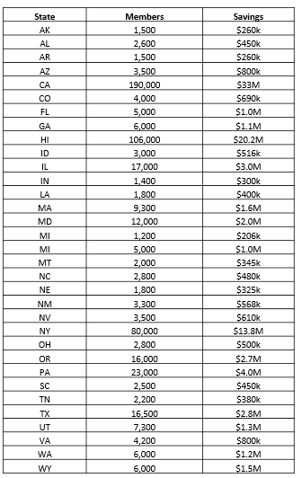
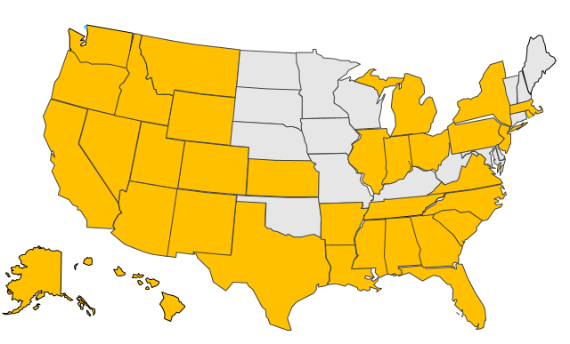
Keenan Pharmacy Services

Slide 28
 | Start Date | Number Enrolled | Savings 2012-13 | Savings 2013-14 | Savings 2014-15 | Savings 2015-16 | Total Savings
Client 1 | Jul-12 | 1,410 | $557,109 | $735,284 | $959,770 | $1,419,721 | $3,671,884
Client 2 | Jul-13 | 599 |  | $401,504 | $507,641 | $730,037 | $1,639,182
Client 3 | Jul-13 | 5,505 |  | $1,147,401 | $1,398,008 | $2,456,200 | $5,001,609
Client 4 | Mar-14 | 4,870 |  | $598,844 | $721,637 | $1,682,816 | $3,003,297
Client 5 | Jul-14 | 1,591 |  |  | $595,396 | $1,083,776 | $1,679,172
Client 6 | Jul-14 | 1,383 |  |  | $387,343 | $735,714 | $1,123,057
Client 7 | Jul-15 | 2,403 |  |  |  | $1,230,611 | $1,230,611
Client 8 | Jul-15 | 11,213 |  |  |  | $1,957,008 | $1,957,008
Client 9 | Jan-16 | 7,809 |  |  |  | $1,024,301 | $1,024,301
TOTAL |  | 36,783 | 557,109 | 2,883,033 | 4,569,795 | 12,320,184 | 20,330,121
BOCES savings to-date in New York: $20.3 million

Slide 29
Questions????
Dr. Mark Jones
Chief Operating Officer
Capital Region Board of Cooperative Educational Services
mark.jones@neric.org
Michele V. Handzel, Esq.
Capital Region Board of Cooperative Education Services
michele.handzel@neric.org

Slide 30
Pharmacy Purchasing Coalition
Shared BOCES service designed to help
self-insured school districts and municipalities manage prescription drug costs by addressing the Five factors that drive up districts costs:
    Employer balanced PBM contract
    Volume-buying
    Best in class pricing
    Minimal formulary disruption
    Per enrollee fees
    Program size does not limit savings

Slide 31
Pharmacy coalition service
10% to 20% savings
Volume discounts
Pharmacy expertise
Transparency
Clear pricing structure
No hidden fees
No lost rebates
BOCES provides communications materials to introduce program
BOCES and Keenan negotiate contracts to save districts and municipalities
Day-to-day account services handled by Keenan (with BOCES as the liaison)

Slide 32
Questions?
Let us help you plan…now or later
Dr. Mark Jones
Chief Operating Officer
(518) 862-4920
mark.jones@neric.org
Michele Handzel, Esq.
School Attorney
(518) 464-5139
michele.handzel@neric.org

